Slide 1
Interfaces
Abstract classes & Interface

Slide 2
Abstract Class
A class that cannot instantiate objects.
Message
Text
Message
Voice
Message
Fax
Message
Public abstract class Message {
}
Abstract classes & Interface

Slide 3
Abstract Class
An abstract class used as supertype
An object cannot be created from an abstract class
An array of the abstract type is used to contain objects of the concrete subclasses
Abstract classes & Interface

Slide 4
From abstract class
To Interface

Slide 5
What is an Interface?
An interface is a collection of constants and method declarations
An interface describes a set of methods that can be called on an object
The method declarations do not include an implementation
  there is no method body

Slide 6
What is an Interface?
A child class that extends a parent class can also implement an interface to gain some additional behavior
Implementing an interface is a “promise” to include the specified method(s)
A method in an interface cannot be made private

Slide 7
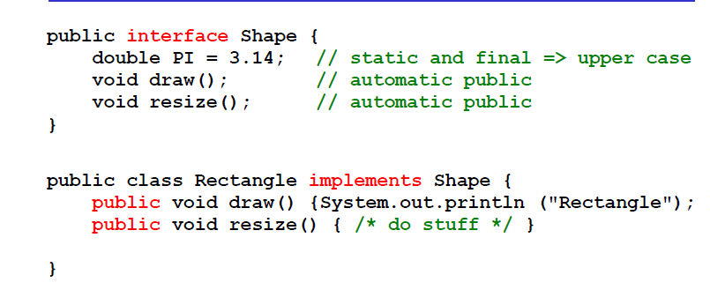
Example
Abstract classes & Interface

Slide 8
When A Class Definition Implements An Interface:
It must implement each method in the interface
Each method must be public (even though the interface might not say so)
Constants from the interface can be used as if they had been defined in the class (They should not be re-defined in the class)

Slide 9
Declaring Constants with Interfaces
Interfaces can be used to declare constants used in many class declarations
  These constants are implicitly public, static and final

Slide 10
Creating and Using Interfaces
Declaration begins with interface keyword
Classes implement an interface (and its methods)
Contains public abstract methods
  Classes (that implement the interface) must implement these methods

Slide 11
Interface Body
The interface body contains method declarations for ALL the methods included in the interface.
A method declaration within an interface is followed by a semicolon (;) because an interface does not provide implementations for the methods declared within it.
All methods declared in an interface are implicitly public and abstract.
Abstract classes & Interface

Slide 12
Implement an Interface
An interface defines a protocol of behavior.
A class that implements an interface adheres to the protocol defined by that interface.
To declare a class that implements an interface, include an implements clause in the class declaration.
Abstract classes & Interface

Slide 13
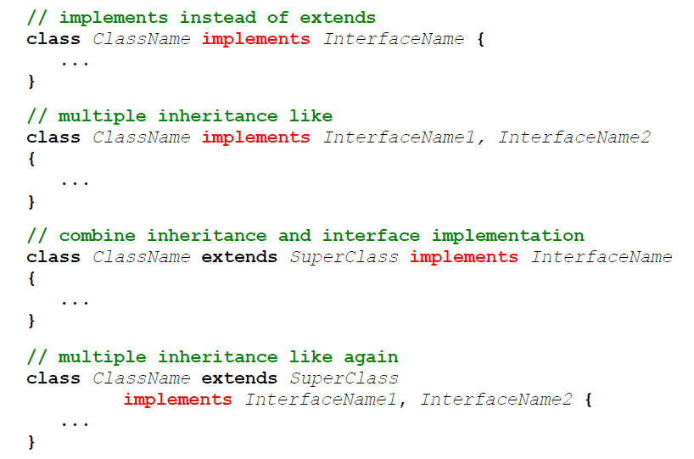
Rules
Abstract classes & Interface

Slide 14
Why Use Interfaces
Java has single inheritance, only
This means that a child class inherits from only one parent class
Sometimes multiple inheritance would be convenient
Interfaces give Java some of the advantages of multiple inheritance without incurring the disadvantages

Slide 15
Why Use Interfaces
Provide capability for unrelated classes to implement a set of common methods
Define and standardize ways people and systems can interact
Interface specifies what operations must be permitted
Does not specify how performed

Slide 16
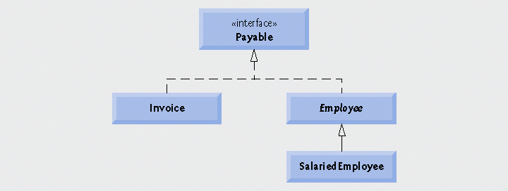
Case Study: A Payable Hierarchy
Payable interface
  Contains method getPaymentAmount
  Is implemented by the Invoice and Employee classes

Slide 17
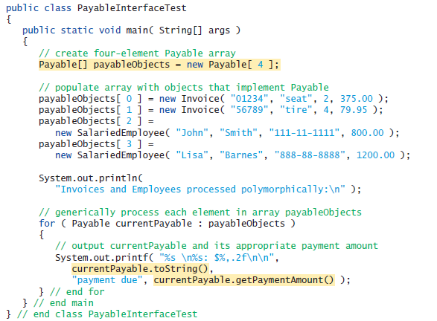
Abstract classes & Interface

Slide 18
Multiple Inheritance
Class A
Class B
Class C
Class ABC
Class ABC inherits all variables and methods from Class A, Class B, and Class C.
Java does NOT support multiple inheritances.
However, you can use interface to implement the functionality of multiple inheritance.
Abstract classes & Interface

Slide 19
Some of Java's Most used Interfaces
Cloneable
  To make a copy of an existing object
Serializable
  Pack a web of objects such that it can be send over a network or stored to disk. And naturally later be restored as a web of objects.
Abstract classes & Interface

Slide 20
The Cloneable Interface
A class X that implements the Cloneable interface tells clients
that X objects can be cloned.
Abstract classes & Interface

Slide 21
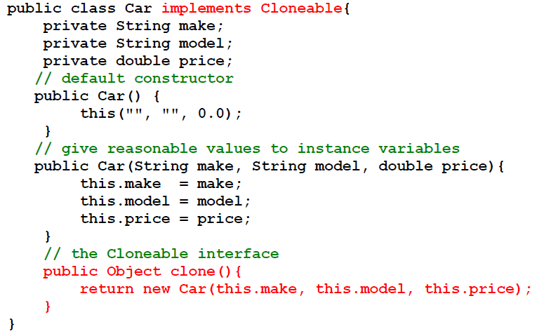
The Cloneable Interface, Example
Abstract classes & Interface

Slide 22
The Cloneable Interface,
newCarObject = oldCarObject.clone();
  Copies newCarObject to a new memory location
newCarObject = oldCarObjec;
  Only assigns the reference of oldCarObjec to newCarObject . No copy is made
Abstract classes & Interface

Slide 23
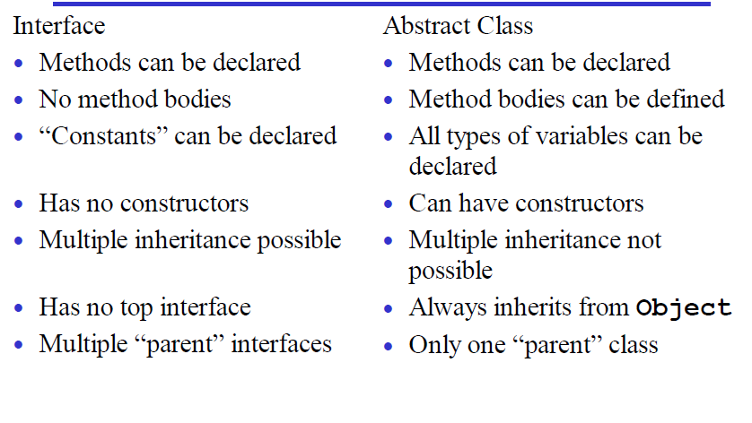
Summary ( Abstract vs Interface)
Abstract classes & Interface

Slide 24
Design guidelines
Use classes for specialization and generalization
Use interfaces to add properties to classes.
Abstract classes & Interface

Slide 25
END
Abstract classes & Interface

